Slide 1
CSS Box Model
Sandeep G

Slide 2
Who Am I?
Engineer / Front End developer
Worked in Software AG, MSFT, SAP
~9 years of experience
Worked in React JS, TypeScript, JS, CSS, HTML

Slide 3

Agenda
Typography in CSS (covered in previous class)
Understanding the box model
Display and positioning in CSS

Slide 4
Box model

Slide 5
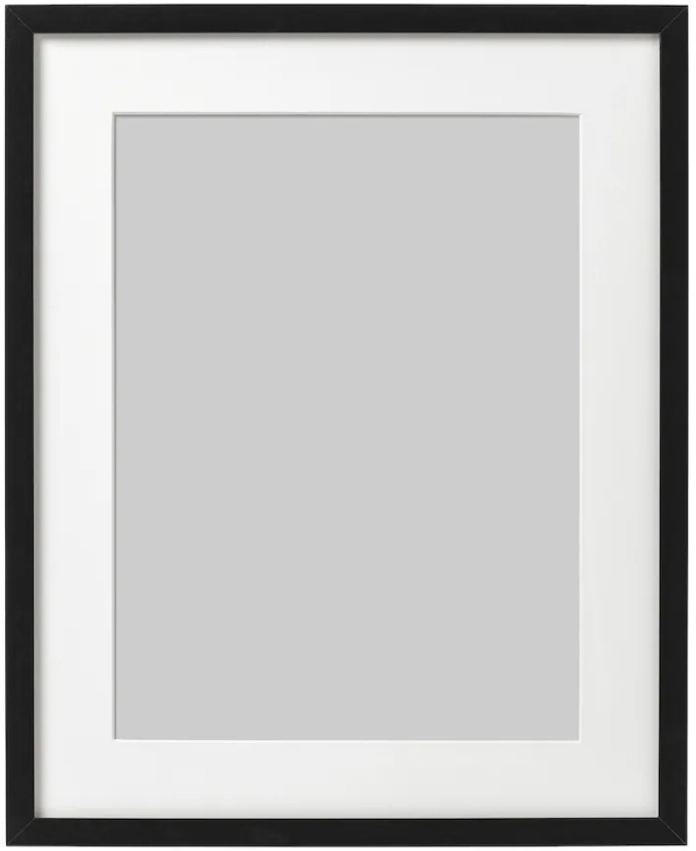
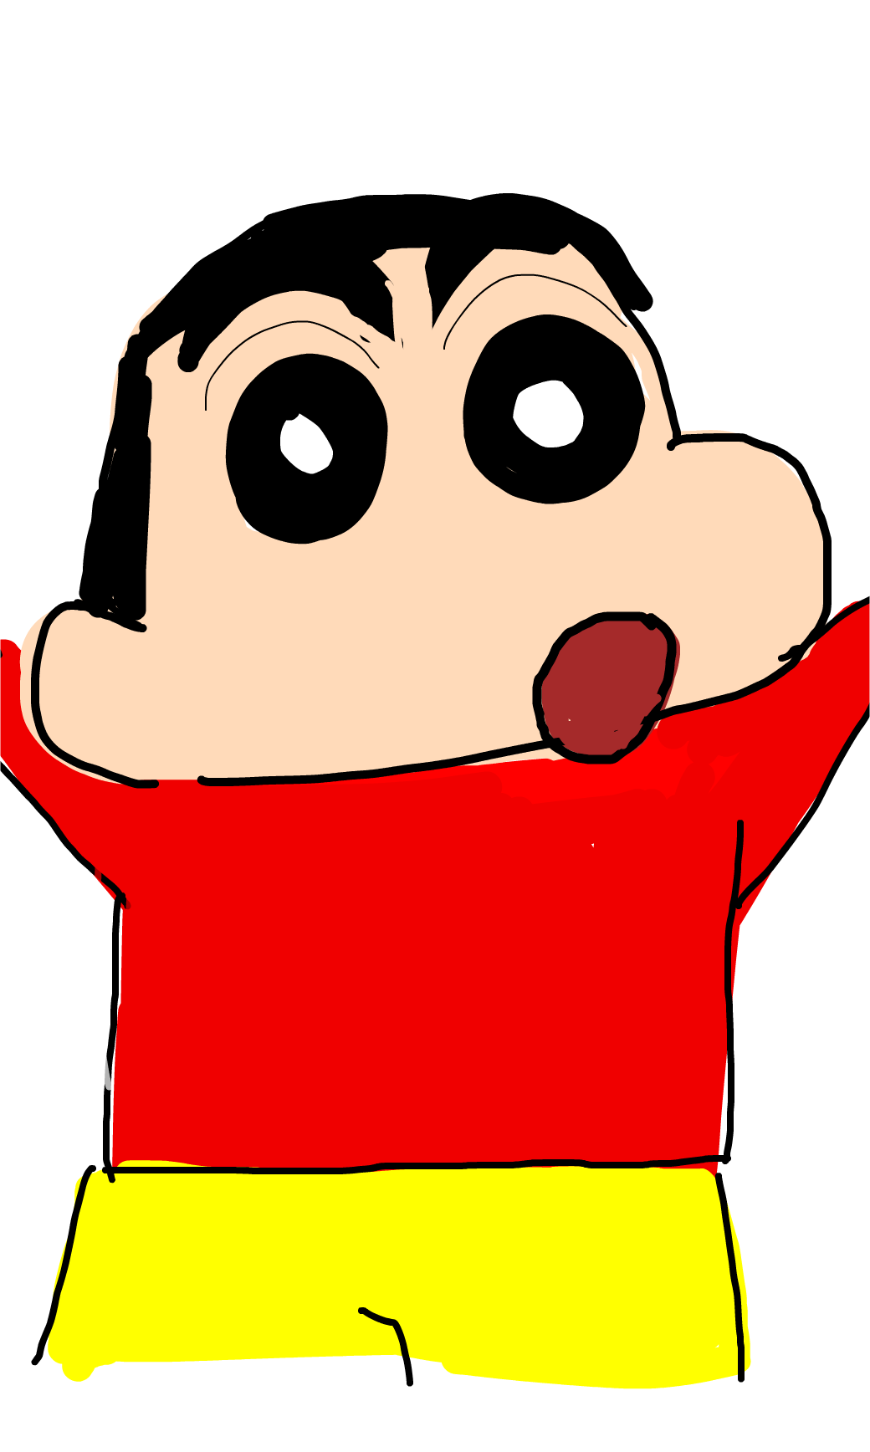
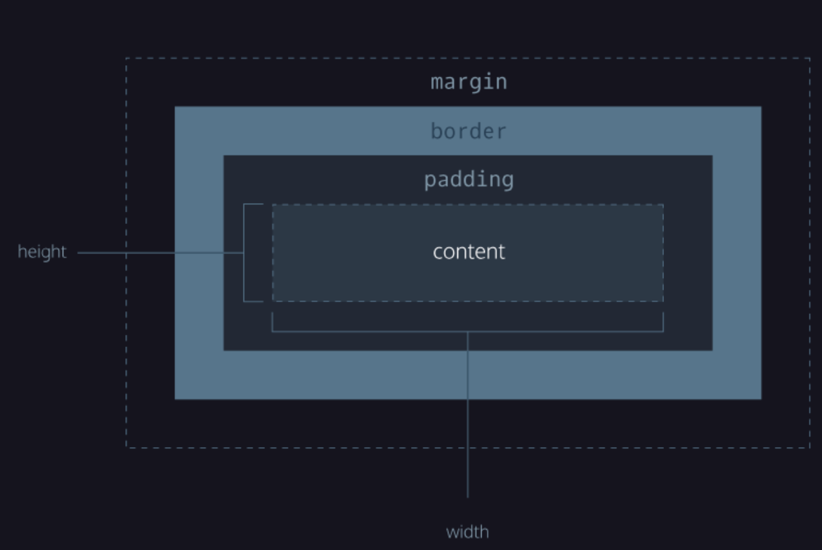
The box model
It defines the part of an element which take up space in webpage
The model include the following -
Width and height of content area
Padding- space between content and border
Border - Thickness and style of border
Margin - Space between border and outside edge.

Slide 6
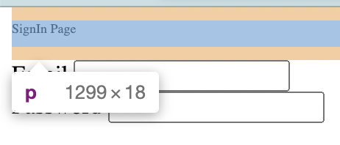
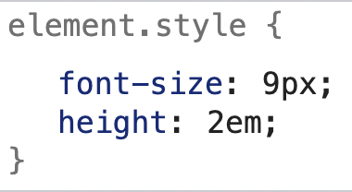
Height and Width
It defines the dimensions of the content.
There are 3 major units to define these -
Pixels - 1/96 of 1 inch.
Percentage - relative to the size of the window.
em - relative to the size of the font. E.g. if the font is 14px, then 2em would be 28px.

Slide 7
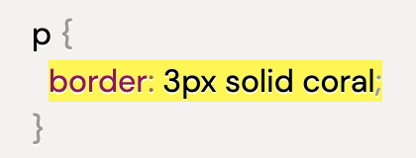
Border
Line surrounding an element is called border.
Border radius helps is modifying corner of elements.

Slide 8
Padding
padding
The space between content of the box and the border.
Increasing the padding, will increase the outside area of the content Hence, used in expanding the background color.

Slide 9
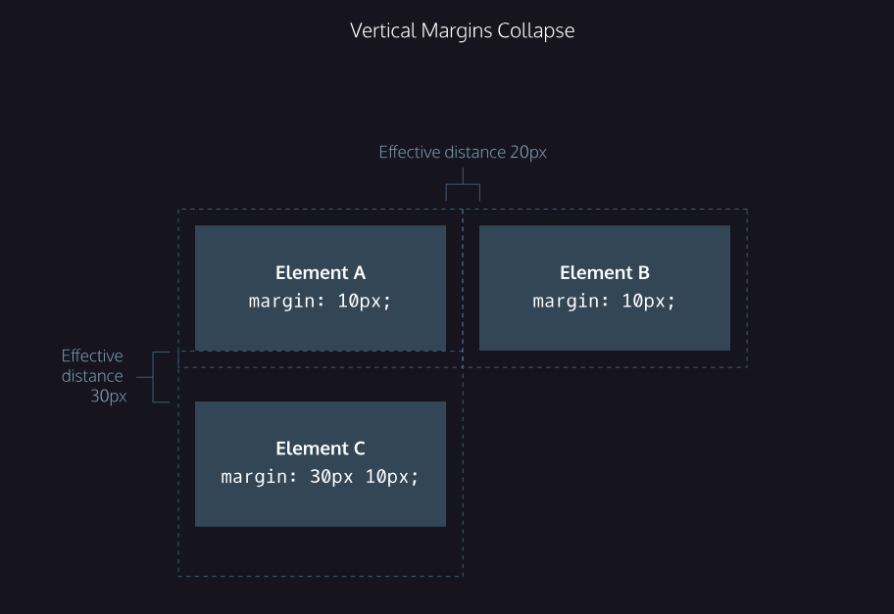
Margin
Margin left: 10px
Space directly outside the border is called margin.
This helps in increasing the space outside the border of content area.
Margin Collapse: From the left image, note that - space between A and B is 20px.
But, space between A & C is 30px, as it took greater of 2 margins.

Slide 10
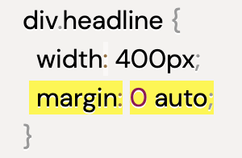
Margin and making center!
Margin can help you to make the contents in center
In order to do that -
Zero will automatically set the top-bottom margin 0. Auto would instruct the browser to put the div to center.

Slide 11
Positioning

Slide 12
Positioning
Position: relative Left: 10px
Bottom: 10px
CSS treats each element as a box, which it either start on a new line(block level) or adjusts in the same line(inline).
CSS position can have the following values -
Position:static(default)
Position:relative - with this css property, element is positioned relative to the normal position.
Position:absolute - An element with position: absolute; is positioned relative to the nearest positioned ancestor.
Position: fixed - It is helped in making an element always visible, even if you scroll down. E.g. navbar
Position: sticky - It would be the normal part of document, but if you scroll to that position it would Stick to a position. Eg. sticky navbar

Slide 13
Z-index property
Controls the order of overlapping elements.
Elements with higher z-index would be placed above.

Slide 14
Visibility & Display

Slide 15
Visibility
The property helps in deciding the visibility of an element.
Following are some of the values -
Hidden - hides the elements, but reserves the place
Visible - shows the elements

Slide 16
Display
The property determines the CSS box in the viewport, whether it should show the element in the same or new line.
Following are some of the values of ‘display’ property -
Display: inline - elements like <em>, <strong>, and <a>, is called inline, which does not start from new line. You can not adjust width and height for it.
Display: block - used for elements when you want to show in a new line.
Display: inline-block - used in the cases when you wish to show multiple blocks in the same line.

Slide 17
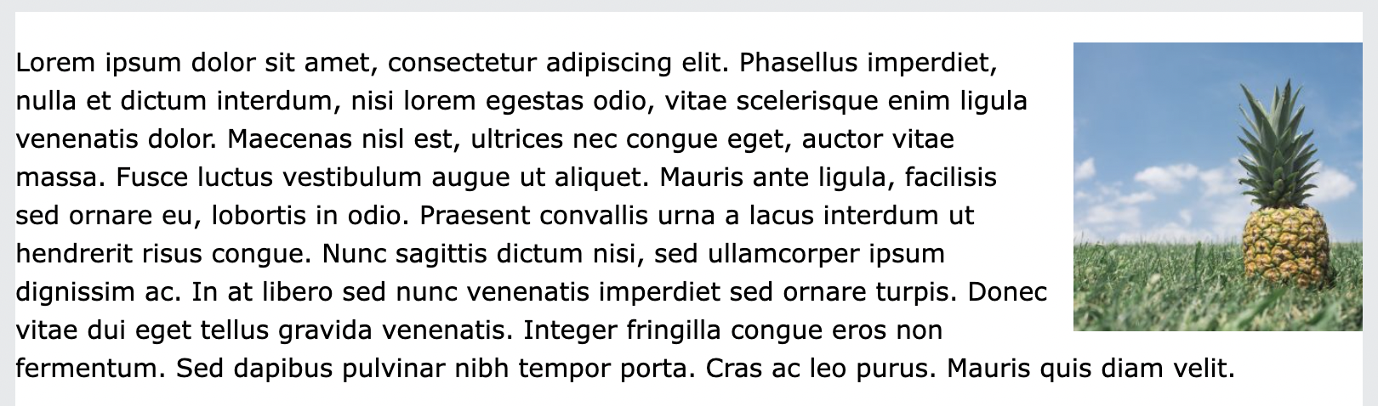
Floating elements
Float property helps to place an element left or right of the parent element.
In the below mentioned webpage, we had the image float:right, which moved to the extreme right.

Slide 18
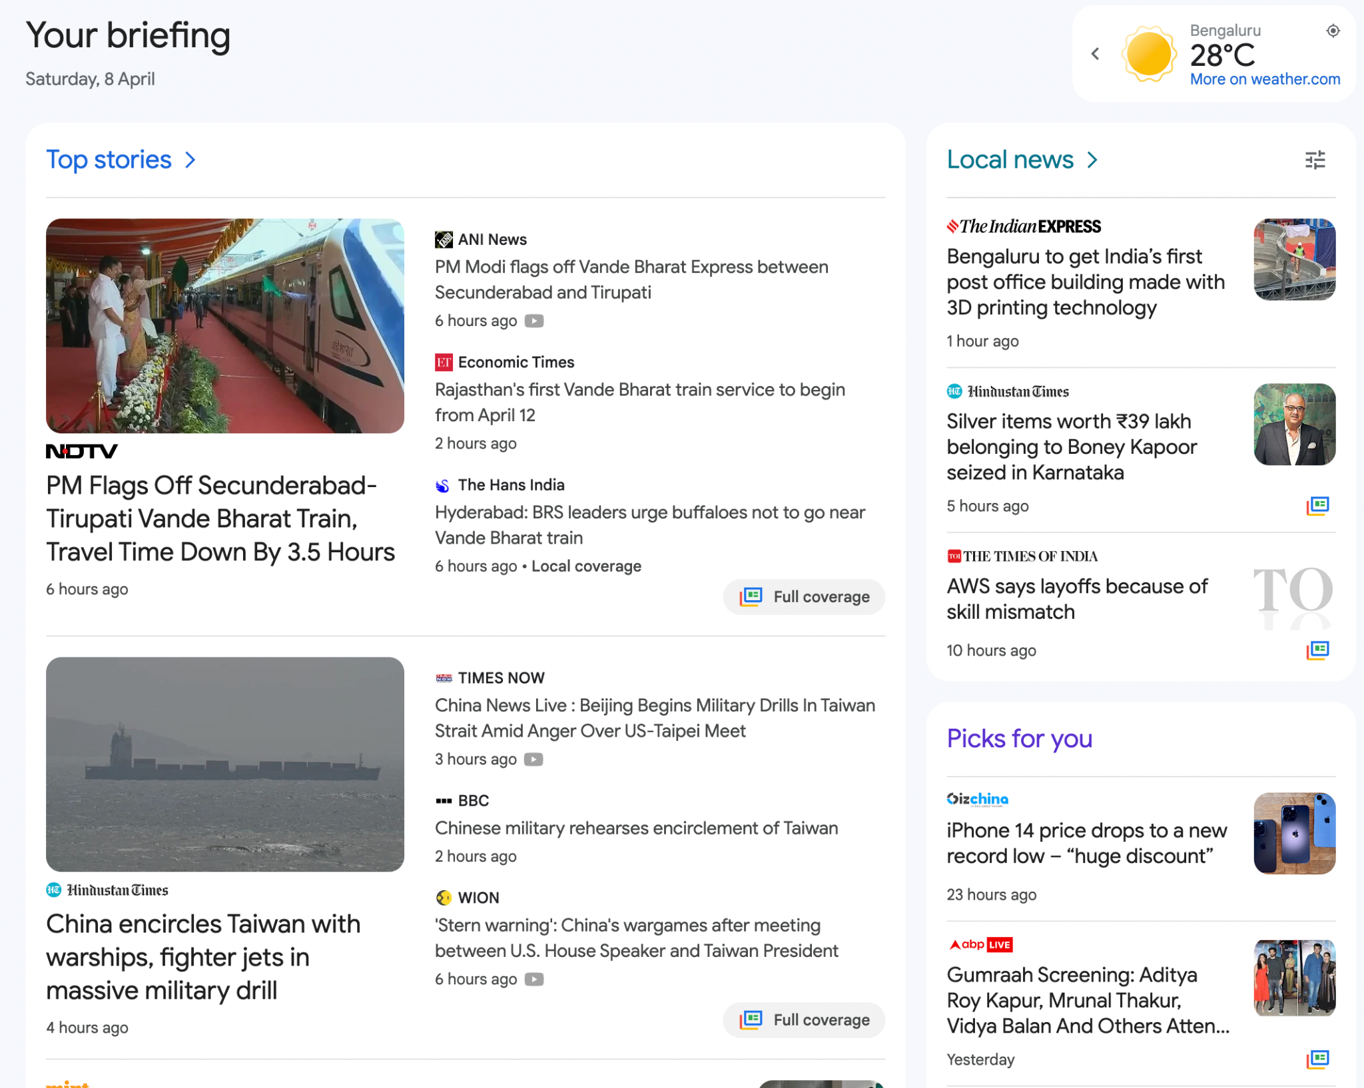
Make this webpage

Slide 19
Thanks and Happy coding!

